Slide 1
CI/CD for Java application
Author: A. Frolov

Slide 2

Agenda
Technology stack;
CI/CD;
Git;
Jenkins pipeline for master branch;
Jenkins pipeline for NOmaster branch;
Testing;
Docker container;
Ansible;
Reporting.

Slide 3











Technology stack
Cloud
Automatization
Programming

Slide 4








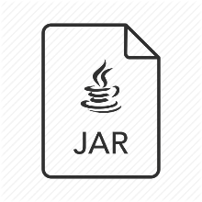







CI/CD
Staging server
Webhook
git push
git commit
Result
Test
Production server
Report

Slide 5
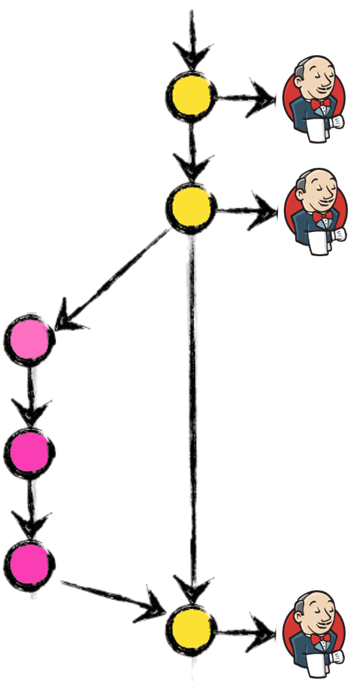
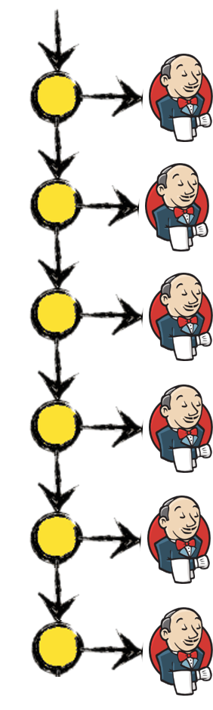

Git
develop branch
master branch

Slide 6
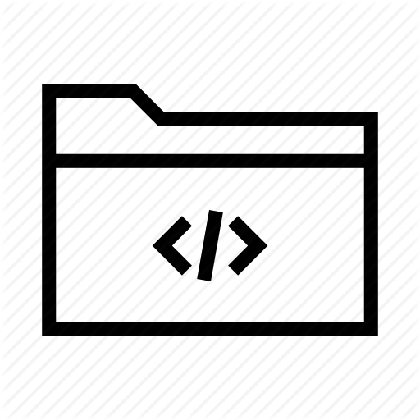
Jenkins pipeline for master branch
Project repository
PRODUCTION server
Clone
Compilation
Build report

Slide 7

Jenkins pipeline for master branch
Project repository
PRODUCTION server
Clone
Compilation
Build report

Slide 8
Jenkins pipeline for NOmaster branch
Project repository
STAGING server
Clone
Compilation
Build report

Slide 9
Jenkins pipeline for NOmaster branch
Project repository
STAGING server
Clone
Compilation
Build report

Slide 10

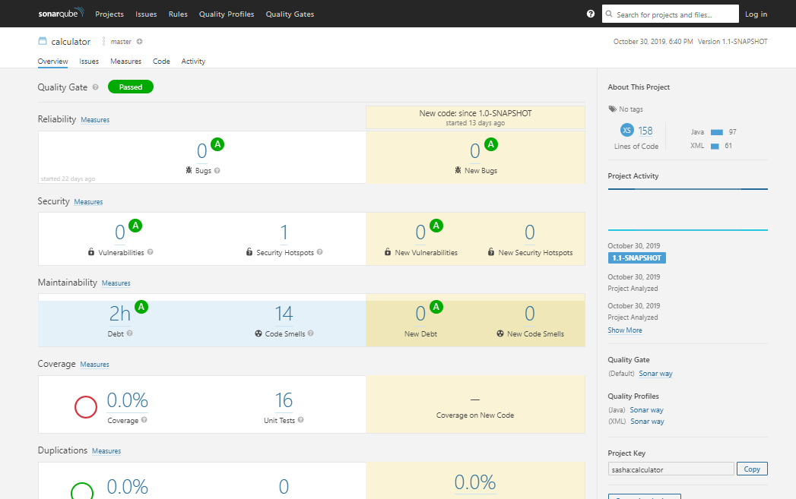


Testing
16 Unit Tests:
Addition (х4)
Subtraction (х4)
Multiplication (х4)
Division (х4)

Slide 11
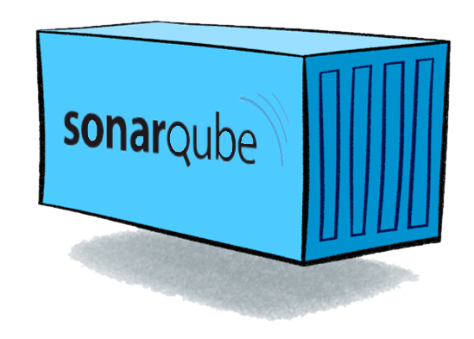


Docker container
Sonarqube
Jenkins master
Jenkins slave

Slide 12





Ansible
Playbook
---
- name: Install Java
hosts: all
become: yes
tasks:
- name: Install aptitude
apt: name=aptitude force_apt_get=yes
- name: Updating repos
apt: name=* state=latest
- name: Install Java
apt: name=openjdk-8-jre state=present
Staging server
Production server

Slide 13

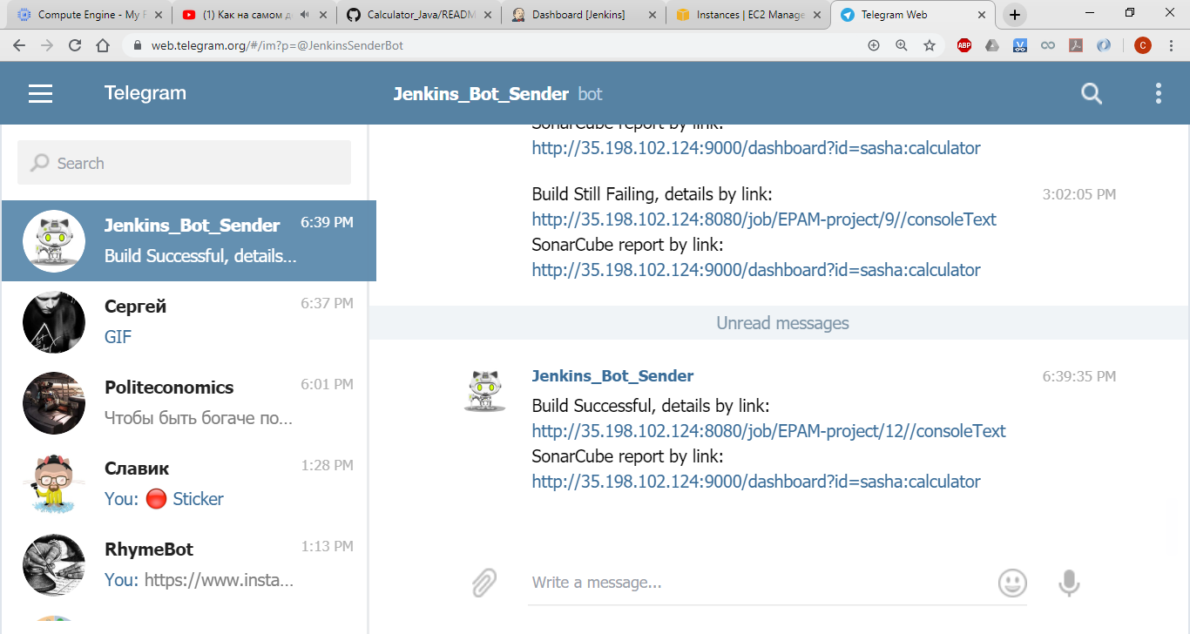


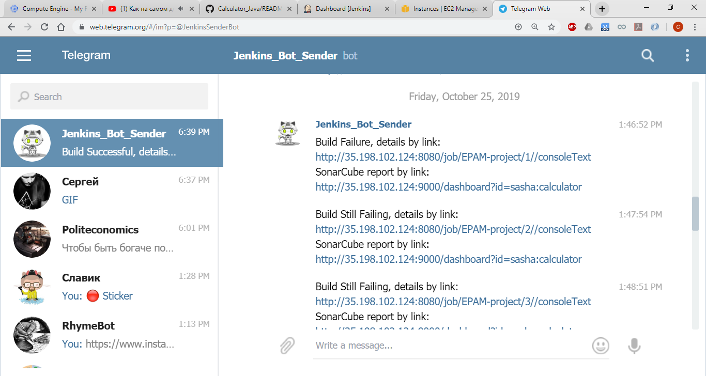
Reporting

Slide 14



Slide 15

Questions
Answers

